Slide 1
Ground Water Assessment
Drought Management Advisory
Council Meeting
March 24, 2011
Nat Wilson (919-715-5445 or nat.wilson@ncdenr.gov)
Ground Water Management Section

Slide 2
Ground Water
Ground water levels are a measure of the amount of water stored that is available to discharge to surface water features
Discharge from ground water to surface water is called “base flow”
Base flow keeps surface water features flowing when rainfall is lacking
Ground water does not flow in under-ground rivers, but slowly through fractures and pore spaces in the subsurface

Slide 3
Drought Indicator Wells
48 wells with a 31 year average record, records range from 5 to 63 years long
19 wells monitored by USGS
Automatic recorders, hourly data, ”real-time” access (within an hour or two of collection)
29 wells monitored by DWR
Automatic recorders, hourly data, downloaded quarterly (Feb, May, Aug & Nov)
All respond to rainfall within hours of an event

Slide 4
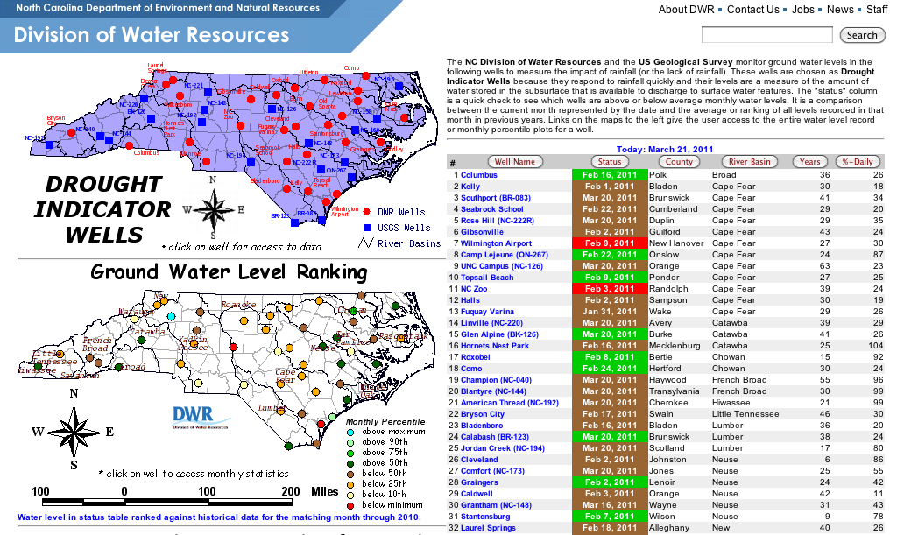
Drought Indicator Wells
Current conditions tab on www.ncdrought.org

Slide 5
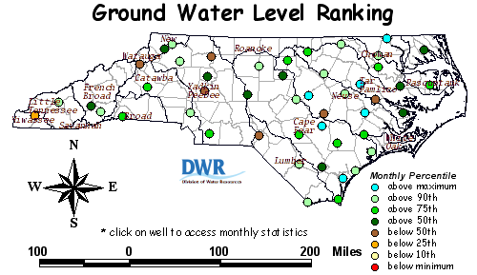
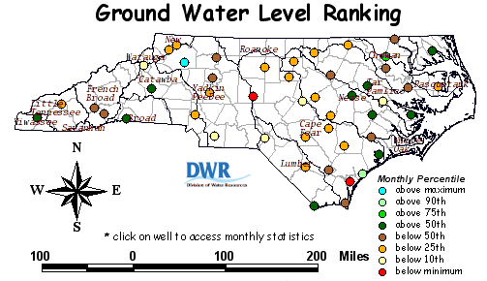
March
2010
March
2011

Slide 7
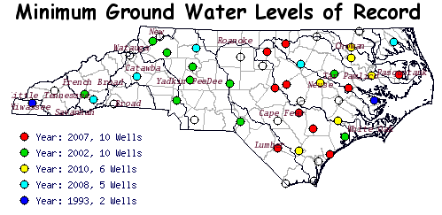
Six wells reached their minimum of record in 2010 even though our March 2010 summary showed higher than normal ground water levels.
Lower than normal ground water levels in March 2011, as we begin to enter the high ET months, keeps me on the lookout for rain.

